Slide 1
Sunway Take Home Assessment
Asyraf Mustaffa

Slide 2
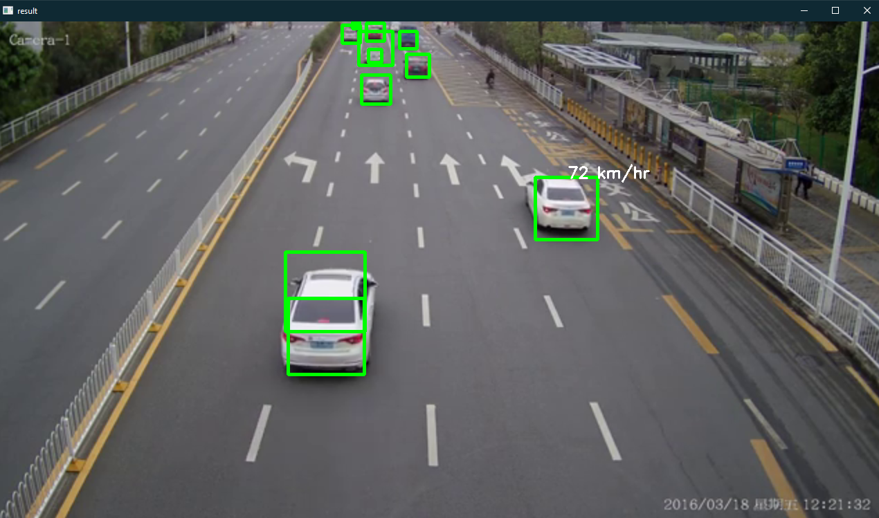
Challenge 1: Traffic Analysis
Use Harr Cascade Classifier to detect cars in video.
Create speed estimate function to calculate speed using Euclidean distance formula.

Slide 3


Challenge 2: Image Processing
Create 3 python function:
Reduce Underexposed Image function
Reduce Exposure Image Function
Reduce Grainy Image Function
Most technique use to improve image quality is by changing contrast and brightness. But each function have their own additional processing such as Gaussian Blur, use LAB color space, CLAHE (Contrast Limited Adaptive Histogram Equalization), and Non-local Mean Denoising.
Grainy image
Enhanced Grainy image

Slide 4
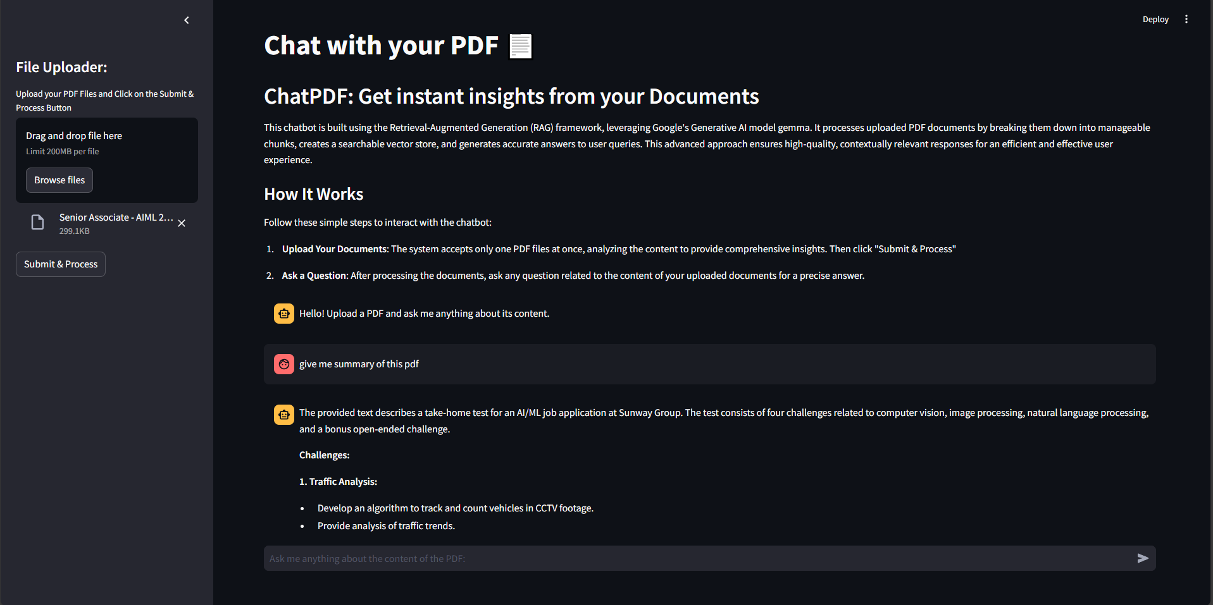
Challenge 3: Generative AI
Use Streamlit as UI Framework.
Uses llama_index and huggingface api to load open-source llm model.
Uses Huggingface embedding model to create vector store for efficient retrieval.

Slide 5
Bonus Challenge
As I don’t have the time to come up with proper proof of concept, but I will share with you my idea.
As Sunway have their own super app, I was thinking that maybe we can build a recommender system for Sunway customer & tourist.
Getting Input from clicks, interacts, and more, can create a recommender and give a discount to persuade them to buy it.

